Slide 1
House Price Prediction Using Machine Learning
Authors-
Ayush VARMA
ABHIJIT SARMA
SAGAR DOSHI
ROHINI NAIR
Name-Swanand Apte
Roll number-1911125
DIVISION-B

Slide 2
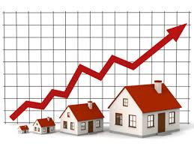
ABSTRACT
Housing prices keep changing day in and day out and sometimes are hyped rather than being based on valuation. Predicting housing prices with real factors is the main crux of our research project. Here we aim to make our evaluations based on every basic parameter that is considered while determining the price.

Slide 3
Keywords
linear regression
machine learning
Prediction
parameters
boosted regression
forest regression
Neural networks

Slide 4
Linear Regression
Linear regression is the most simple method for prediction. It uses two things as variables which are the predictor variable and the variable which is the most crucial one first whether the predictor variable and su. These regression estimates are used to explain the relationship between one dependent variable and one or more independent variables. The equation of the regression equation with one dependent and one independent variable is defined by the formula
b = y + x*a
where, b = estimated dependent variable score, y =constant, x = regression coefficient, and a = score on the independent variable.

Slide 5
Forest Regression
Forest regression uses the technique called as Bagging of trees. The main idea here is to decorrelate the several trees. We then reduce the Variance in the Trees by averaging them. Using this approach, a large number of decision trees are created. Random forest training algorithm applies the technique of bootstrap aggregating, or bagging, to tree learners.
Given a training set X = x1, ..., xn with responses Y =y1, ..., yn, bagging repeatedly (B times) selects a random sample with replacement of the training set and fits trees to these samples: For b = 1, ..., B:
1. Sample, with replacement, n training examples from X, Y; call these Xb, Yb.
2. Train a classification or regression tree fb on Xb, Yb.
After training, predictions for unseen samples a' can be made by averaging the predictions from all the individual regression trees on a':
Additionally, an estimate of the uncertainty of the prediction can be made as the standard deviation of the predictions from all the individual regression trees on a':

Slide 6
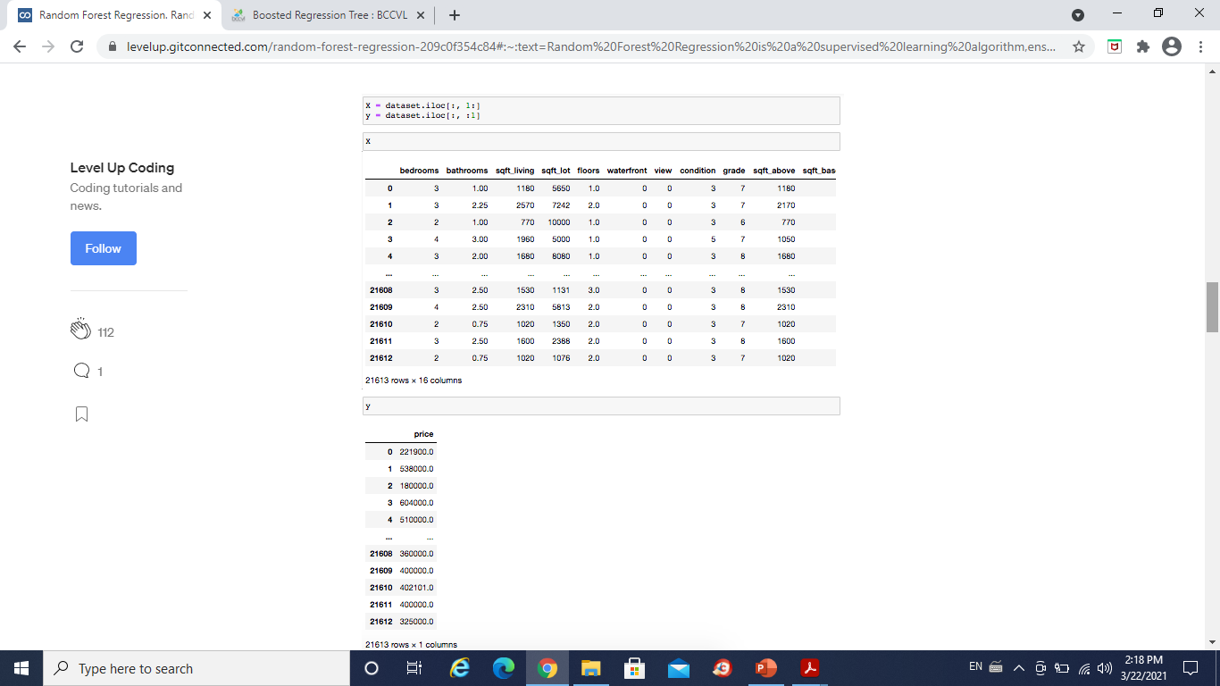

Slide 7
Boosted Regression
Boosted regression is a type of learning technique which produces prediction with the help of decision trees that usually ensemble a number of weak prediction models.
This Boosting algorithm assumes a real life value y and seeks an approximation F(x) in the form of a weighted sum of hi(x) from class H called weak learners:
Figure 2: Boosted regression model

Slide 8


Neural Networks
The results of all the above algorithms are fed as input to the neural network. We use neural network applied with boosted regression to increase the accuracy of the result. Neural network does the job pretty well by comparing all the predictions and computing them to display the most accurate result

Slide 9
Scope
A major future update could be the addition of larger cities to the database, which will allow our users to explore more houses, get more accuracy and thus come to a proper decision.
A learning system can be created which will gather users feedback and history so that the system can display the most suitable results to the user according to his preferences.
Location of the house also needs to be considered as it majorly affects the price of the property.

Slide 10
Conclusion
The system makes optimal use of Linear Regression, Forest regression, Boosted regression. The efficiency of the algorithm has been further increased with use of Neural networks. The system will satisfy customers by providing accurate output and preventing the risk of investing in the wrong house. Additional features for the customer’s benefit can also be added to the system without disturbing it’s core functionality.

Slide 11
Implementation Details
Collect the data with respect to various parameters.
Train the dataset
Test the dataset
Predict the value of the house according to the user’s input using one of the regression model.

Slide 12
References
[1] A. Adair, J. Berry, W. McGreal, Hedonic modeling, housing submarkets and residential valuation, Journal of Property Research, 13 (1996) 67-83.
[2] O. Bin, A prediction comparison of housing sales prices by parametric versus semi-parametric regressions, Journal of Housing
Economics, 13 (2004) 68-84.
[3] T. M. Oshiro, P. S. Perez, and J. A. Baranauskas, “How many trees in a random forest?” In Lecture Notes in Computer Science (including subseries Lecture Notes in Artificial
Intelligence and Lecture Notes in Bioinformatics), vol. 7376 LNAI, 2012, pp. 154–168, ISBN: 9783642315367. DOI: 10 . 1007 / 978 - 3 –
642 -31537-4\ 13
[4] J. Schmidhuber, “Multi-column deep neural networks for image classification,” in Proceedings of the 2012 IEEE Conference on
Computer Vision and Pattern Recognition (CVPR), ser. CVPR ’12, Washington, DC, USA: IEEE Computer Society, 2012, pp. 3642–
3649, ISBN: 978-1-4673-1226-4. [Online].
[5] T. Kauko, P. Hooimeijer, J. Hakfoort, Capturing housing market segmentation: An alternative approach based on neural network modeling, Housing Studies, 17 (2002) 875-894.
[6] R. J. Shiller, “Understanding recent trends in house prices and home ownership,” National Bureau of Economic Research, Working
Paper 13553, Oct. 2007. DOI: 10.3386/w13553.[Online].
[7] The elements of statistical learning, Trevor Hastie - Random Forest Generation
[8] C. M. Bishop, Pattern Recognition and Machine Learning, Springer, 2006
[9] S. Yin, S. Ding, X. Xie, and H. Luo, “A review on basic data-driven approaches for industrial process monitoring,” IEEE Transactions on Industrial Electronics, 2014.
[10] Friedman, J. 2001. Greedy function approximation: a gradient boosting machine. Annals of Statistics 29(5):1189–1232.
[11] R. T. Azuma et al., “A survey of augmented reality,” Presence, vol. 6, no. 4, pp. 355–385, 1997.

Slide 13
Thank You!!

